Slide 1

Inventory Management
TEAM 1

Slide 2
Optimizing Inventory Management
Balancing Stock Levels
An effective inventory system minimizes both excess stock and stock shortages, ensuring smooth operations and customer satisfaction.
Reducing Holding Costs
Strategies aimed at decreasing the cost of holding inventory, which includes warehousing, insurance, and depreciation, driving profitability.
Improving Availability
Ensuring that products are readily available to meet customer demands without delay, thus enhancing the overall customer experience.

Slide 3
Business Problem Statement
Company Overview: Ace Electronics specializes in a wide range of consumer electronics with a commitment to quality and customer service.
Key Issues:
Frequent Stockouts
Overstocking
Inefficient Demand Forecasting
High Holding Costs
Core Questions: What strategies will effectively resolve these inventory management challenges and improve overall performance?

Slide 4
Methodology
Data Collection and Cleaning
Data Structuring and Preprocessing
Creating new columns using the data given to get more information about the inventory.
For example: Making a column telling product is expired or not.
Analytical Calculations
Using Pivot tables to summarize stock by category, rating, and expiry.
Visualization
Use charts to reveal patterns
Insight Derivation
Based on the visualizations and summary statistics

Slide 5
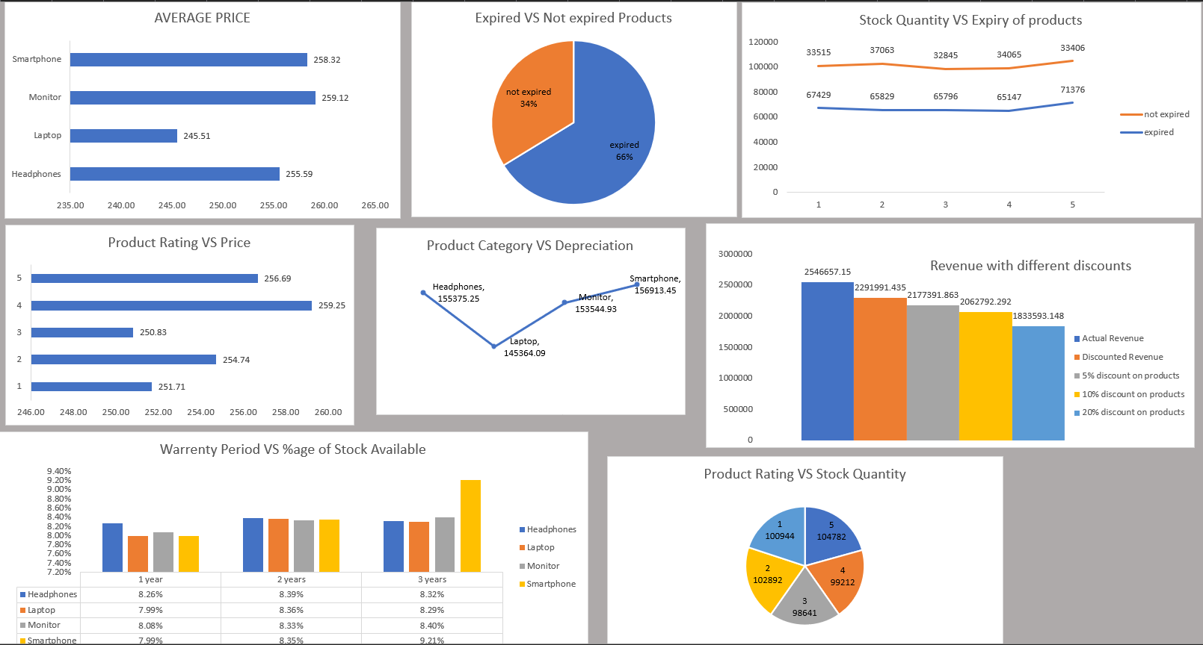

Slide 6
Business Insights
66% of products are expired, indicating a major issue with inventory turnover and lifecycle
tracking.
Stock levels of expired products are consistently high (~65,000) over time, suggesting
that old inventory isn’t being liquidated effectively
The number of non-expired products (~37,000) is consistently lower than expired ones,
risking product availability and lost sales on current-demand items.
Stock levels are almost evenly distributed across product ratings,
with low-rated (1 and 2 stars) items making up 40% of inventory.
Most product categories have a fairly balanced stock distribution across
1–3 years warranty periods, with Smartphones showing a spike (9.21%) at 3 years.

Slide 7
Business Recommendations
Prioritize clearance of expired & low-rated inventory via targeted promotions.
Review procurement strategy to reduce overstock of slow-moving or depreciating items.
Introduce smart discounting — focus it on aged inventory only, not across the board.
Link product ratings with pricing and procurement decisions.
Improve product lifecycle tracking and restocking logic using inventory age and sales velocity.

Slide 8
Key Takeaways and Future Directions
Product Expiry Status Is a Major Concern.
There is an opportunity to review pricing strategy and enhance differentiation.
Broad discounting significantly reduces revenue—should be applied only to non-performing/aging stock.
Too much capital is tied in poorly rated inventory; consider markdowns or phasing out such products.

